Slide 1
The AIHTSagamIMK HUB launched a Continuing Medical Education(CME) and Continuing Professional Development (CPD) Centre for Excellence(CE).
The AIHTSagamHUB CME/CPD/CE in partnership/collaboration with the Kenya Medical Professional and Dentists Board, and McMaster University/Machealth Division of eLearning Innovations, offers multiple learning opportunities to health care providers across the African region.
The AIHT Sagam IMK CME/CPD CE programs will support best practices in delivery of health services in a patient-centered environment.

Slide 2
AIHTSagam HUB powered by IMIENS Intelligent Medical Systems
24/7 real-time access to healthcare providers across the African region regardless of remoteness.
Programs embrace a competency-based approach for personal advancements and growth.
Further extends developments of local resource capacities for self-efficacy, empowerment of internal resources.

Slide 3
AIHTSagam/Machealth CME/CPD Africa Programs - Registration Steps
Kindly proceed to the next slide for steps to register to view locally developed and localised AIHTSagam HUB /Machealth programs.
Please note that you will find attached the McMaster University / Machealth /AIHTSagam CME/CPD Africa “Getting Started Guide” that you may find helpful.

Slide 4
Step 1 - Please visit the HUB http://www.aihtsagamhub.com

Slide 5
Step 2 – Please register to create an account on the HUB

Slide 6
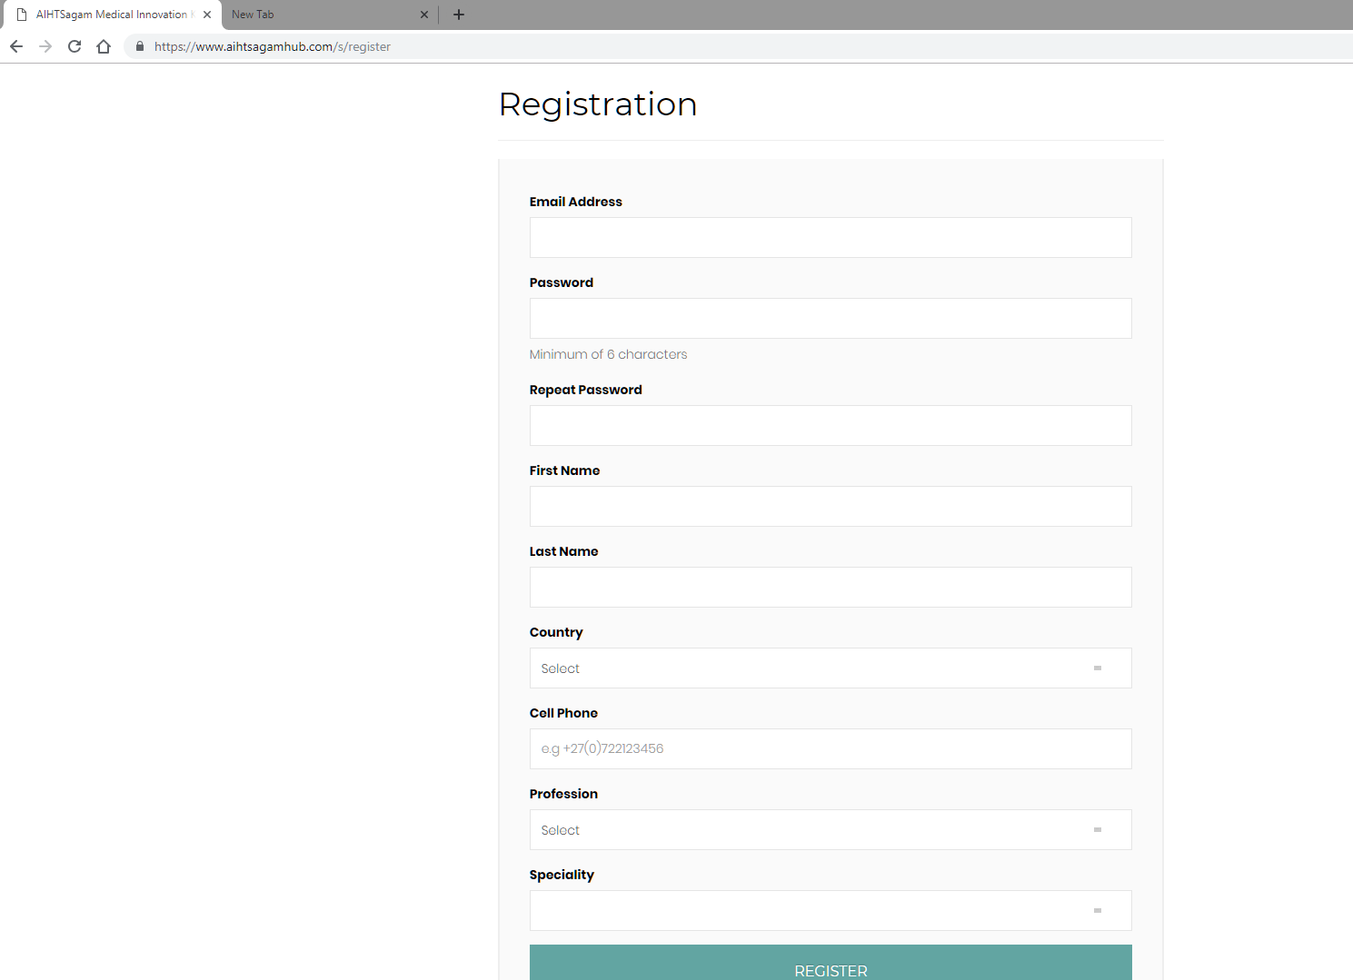
Step 3 – Please complete all information, including your specialty

Slide 7
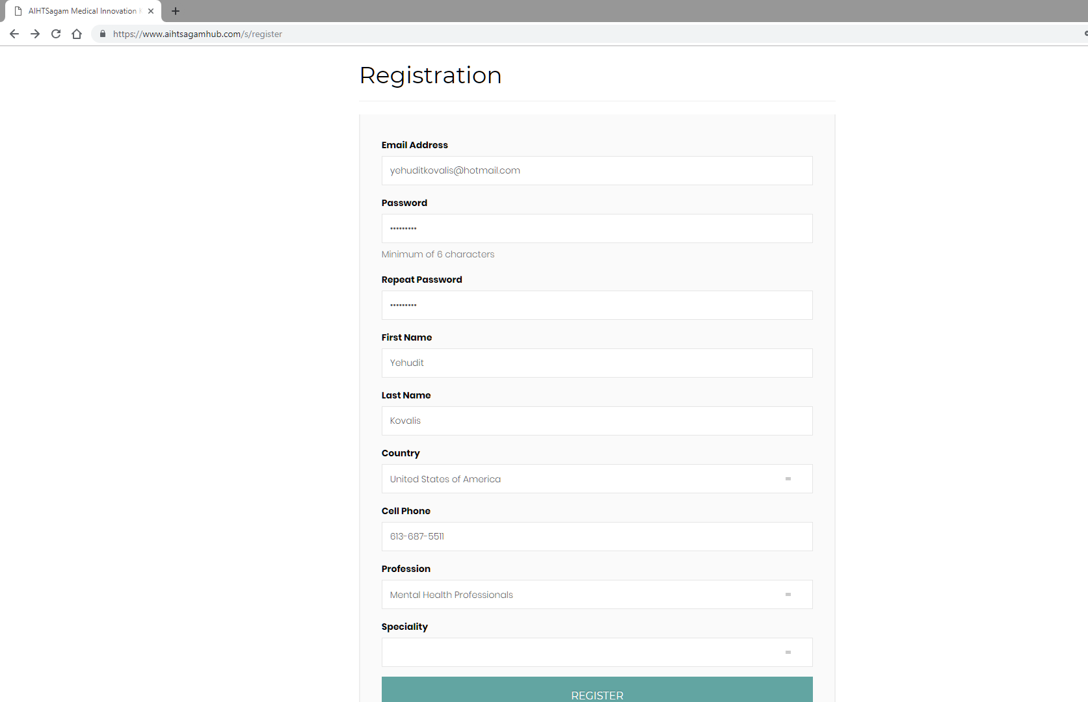
Step 3 A– Example of completed information – then please select the REGISTER button

Slide 8
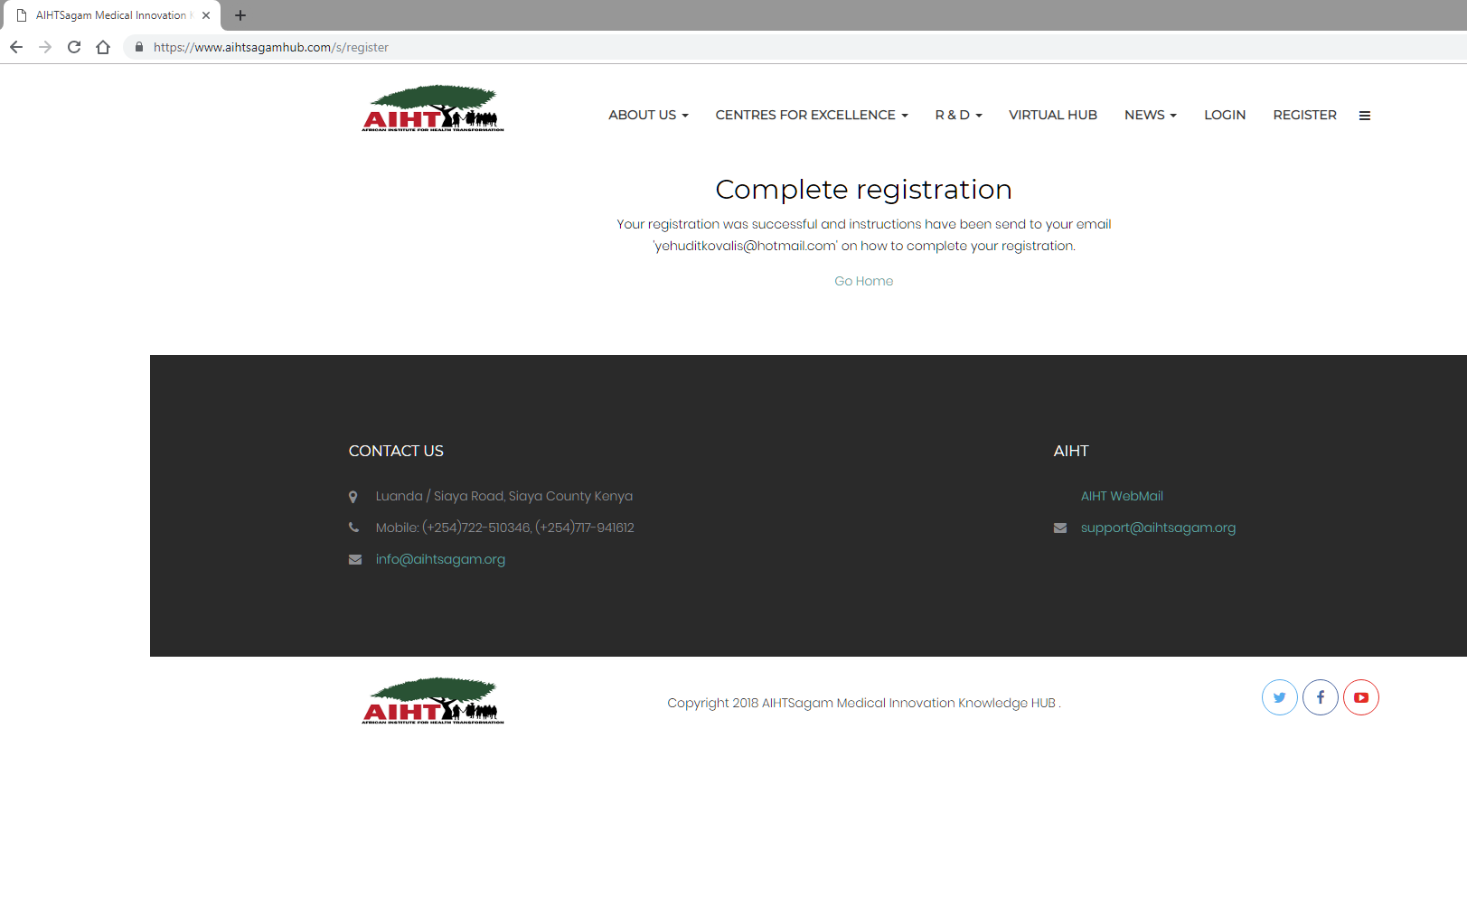
Step 4 – You will receive an email with instructions

Slide 9
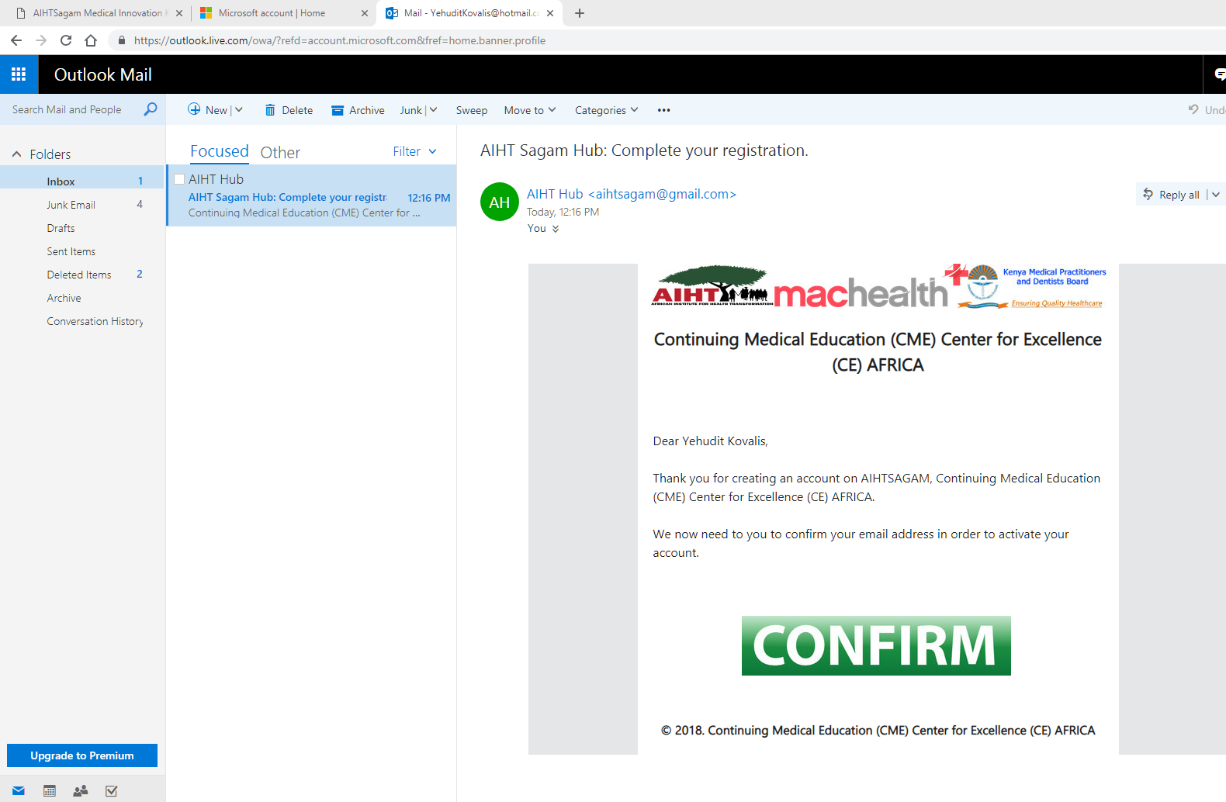
Step 5– You will receive an email from the HUB – Please CONFIRM

Slide 10
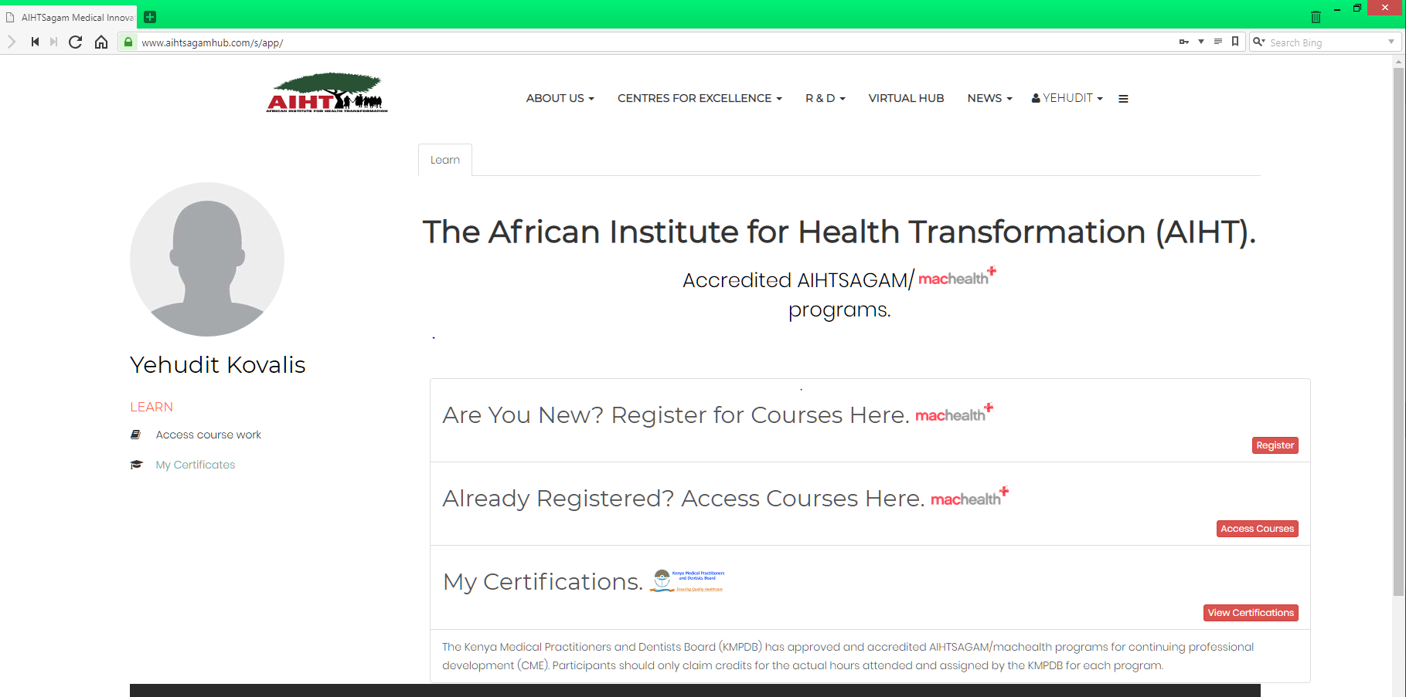
Step 6 – Upon confirmation you will be redirected back to the AIHT McMaster CPD private group environment

Slide 11
Step 7– Please now register for the AIHT Machealth courses (this will only need to be done once for security)

Slide 12
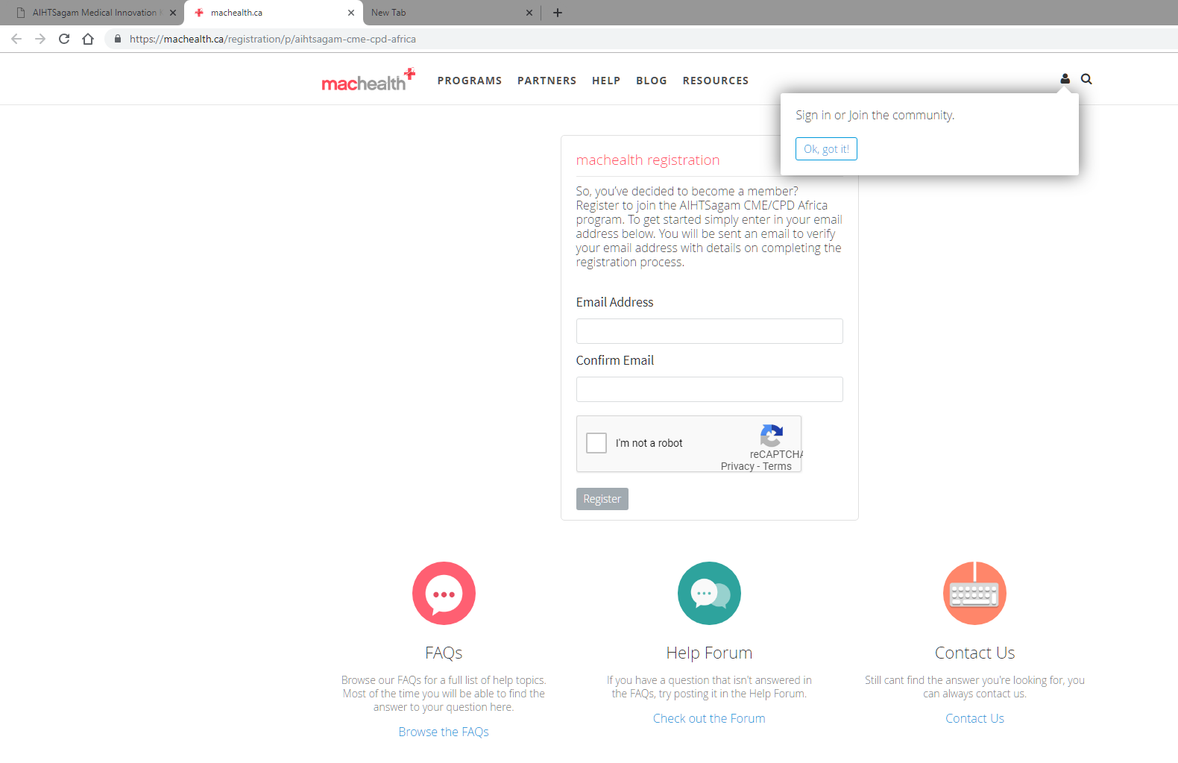
Step 8 – Please complete the registration information

Slide 13
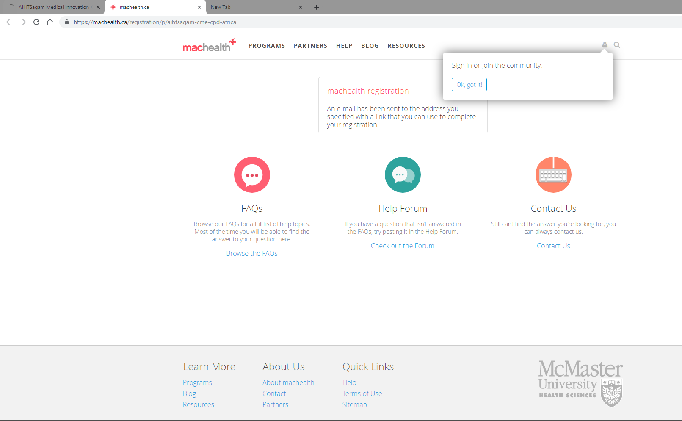
Step 9– Please return to your email to complete the final step to your machealth registration

Slide 14
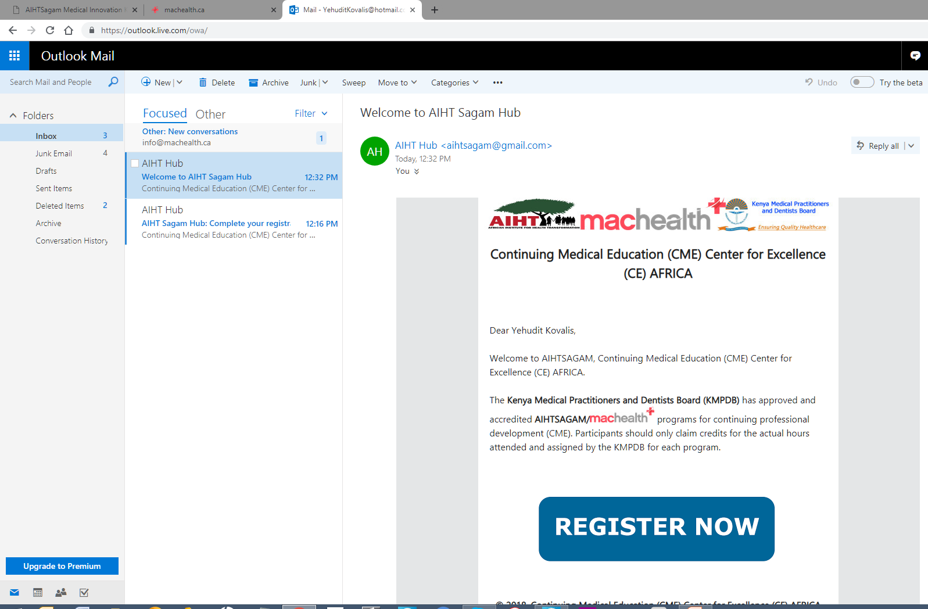
Step 10 – Please finalize your machealth registration by selecting REGISTER NOW

Slide 15
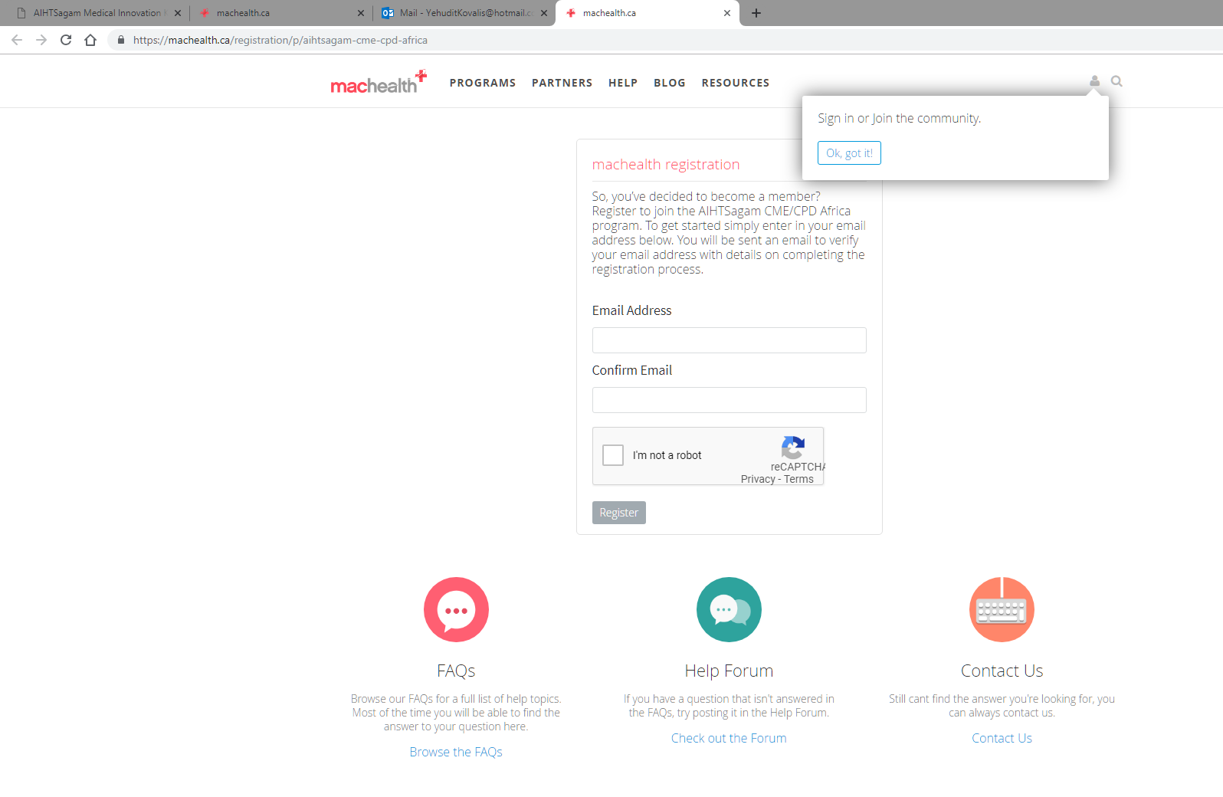
Step 11 – You will be returned to the Sign in area – Please do not select sign in – rather return to your personal email inbox for machealth registration completion

Slide 16
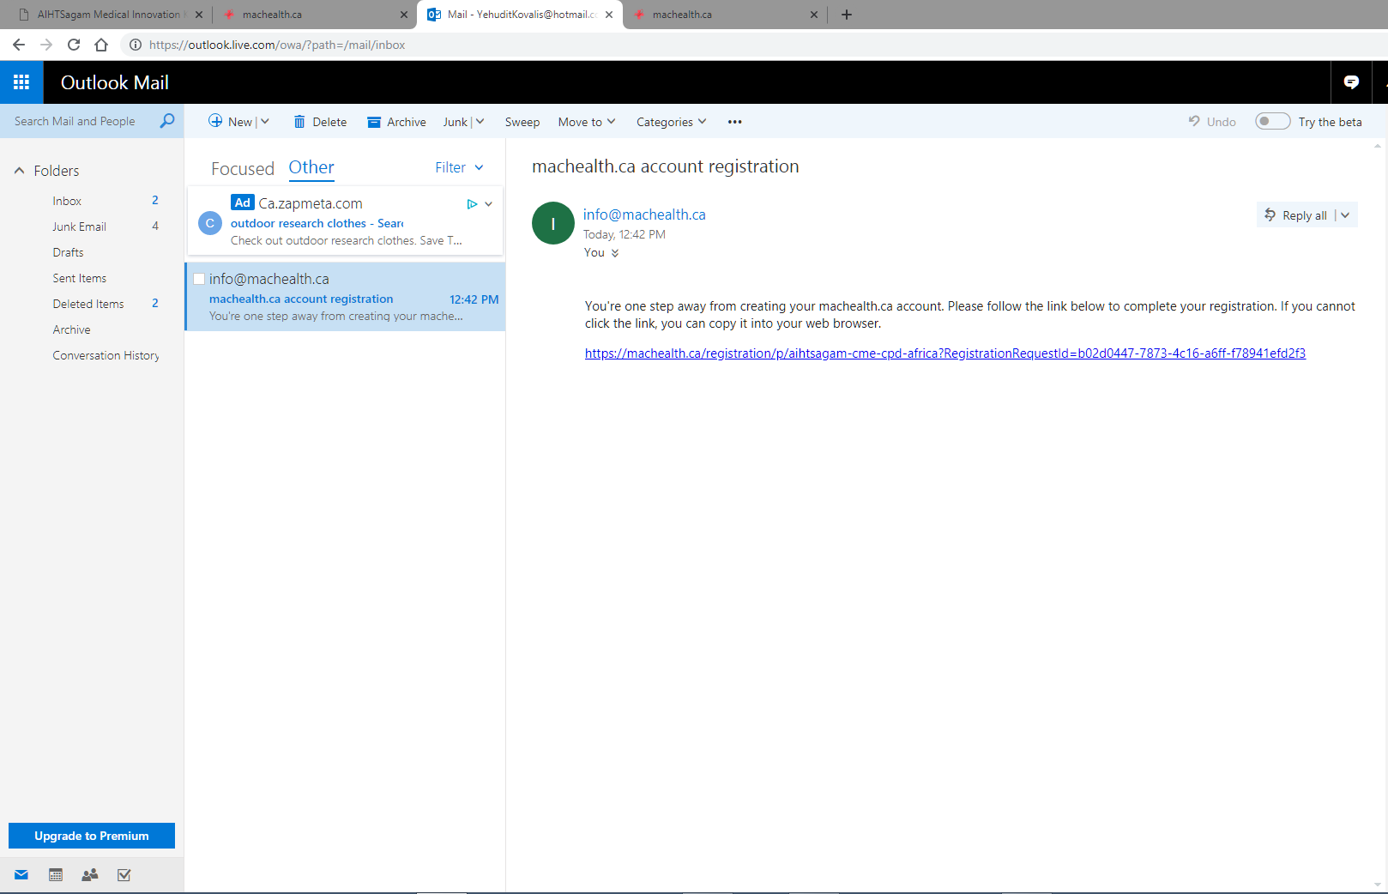
Step 12 – Please follow the link sent to your personal email inbox for machealth registration completion

Slide 17
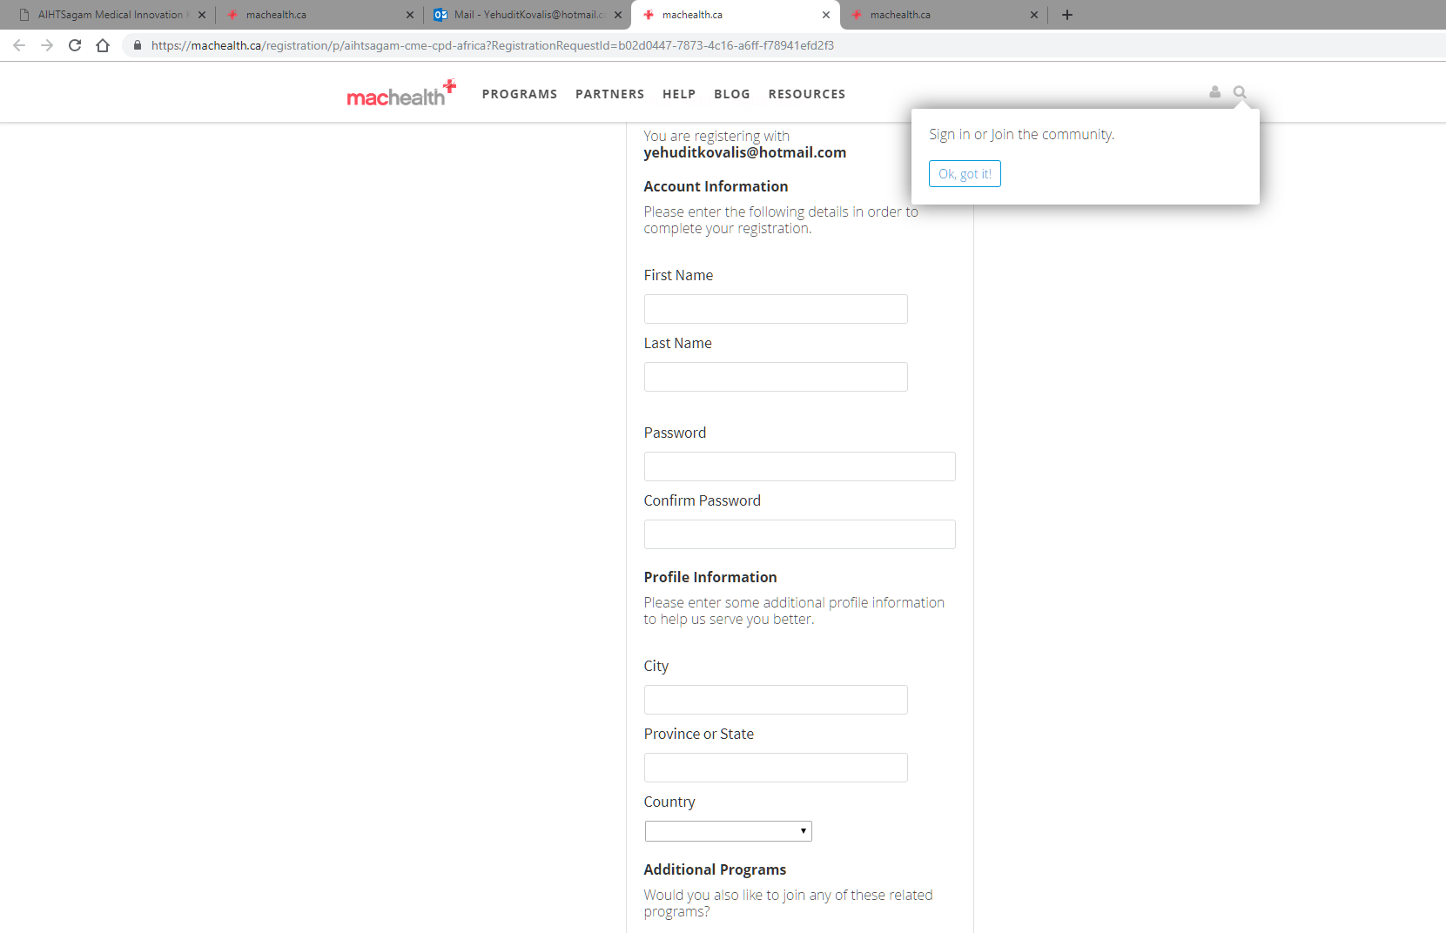
Step 10 – Please complete, along with your personal password, to finalize the machealth registration

Slide 18
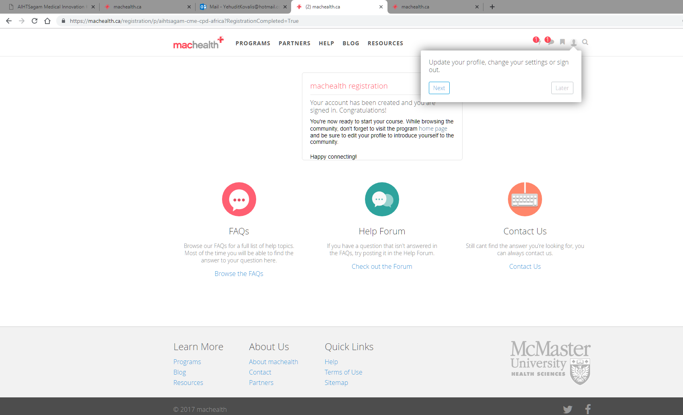
Step 11 - Once you enter all the information and agree to the terms and conditions your will be brought to this page

Slide 19
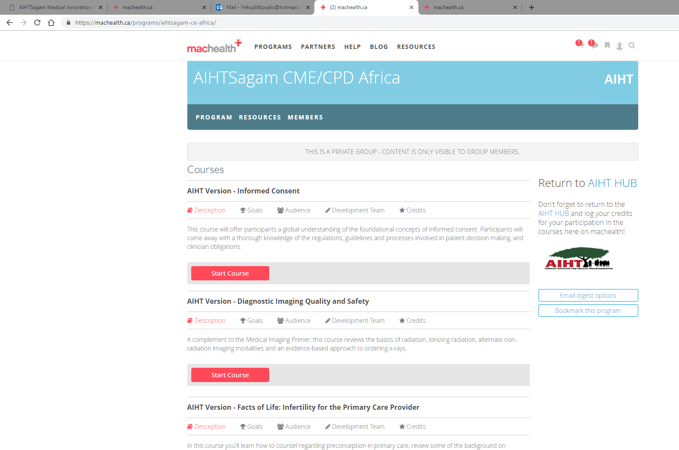
Step 12 – You now have access to all the courses which are localized. Please note that many additional localized courses will be continuously added

Slide 20
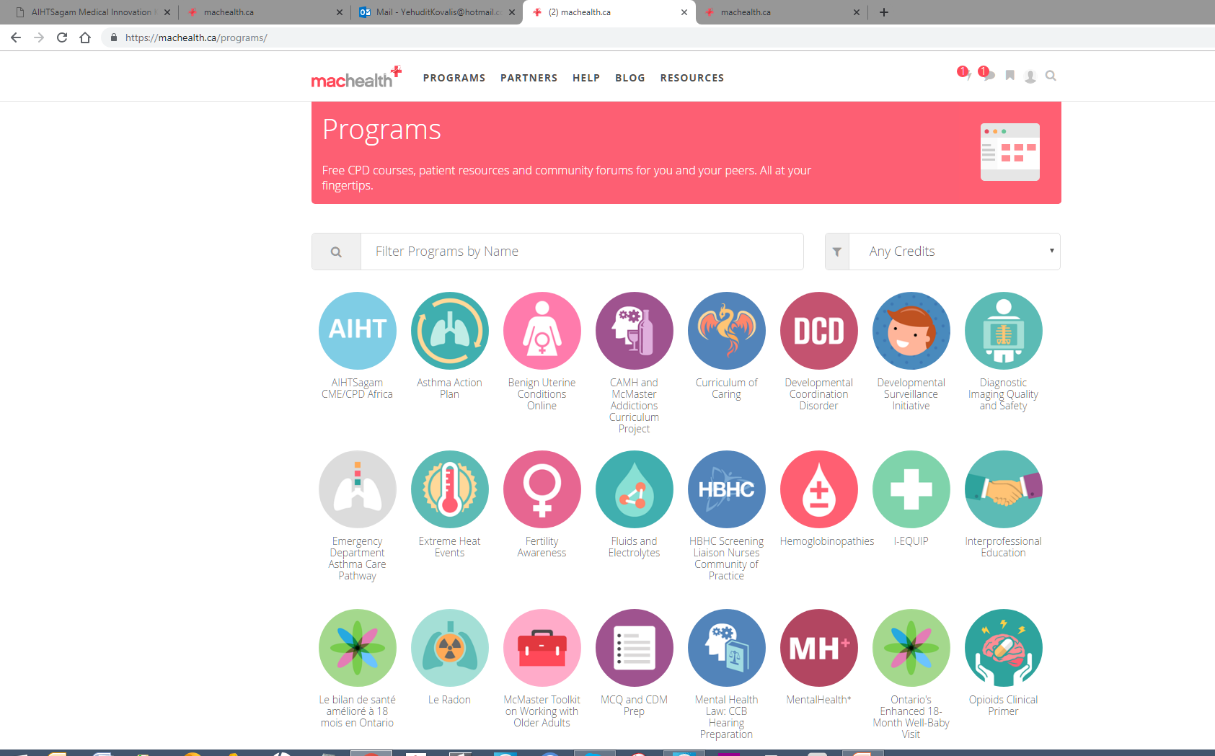
Step 13
You are welcome to explore all Machealth programs. To qualify for accreditation with the KMPDB you must be registered and complete all requirements as required by the AIHT/Macheatlh HUB
.

Slide 21
PART TWO
We will take you through an example of one of
The AIHT/Machealth localized courses.
For this purpose we will select:
AIHT Version – Diagnostic Imaging Quality and Safety

Slide 22
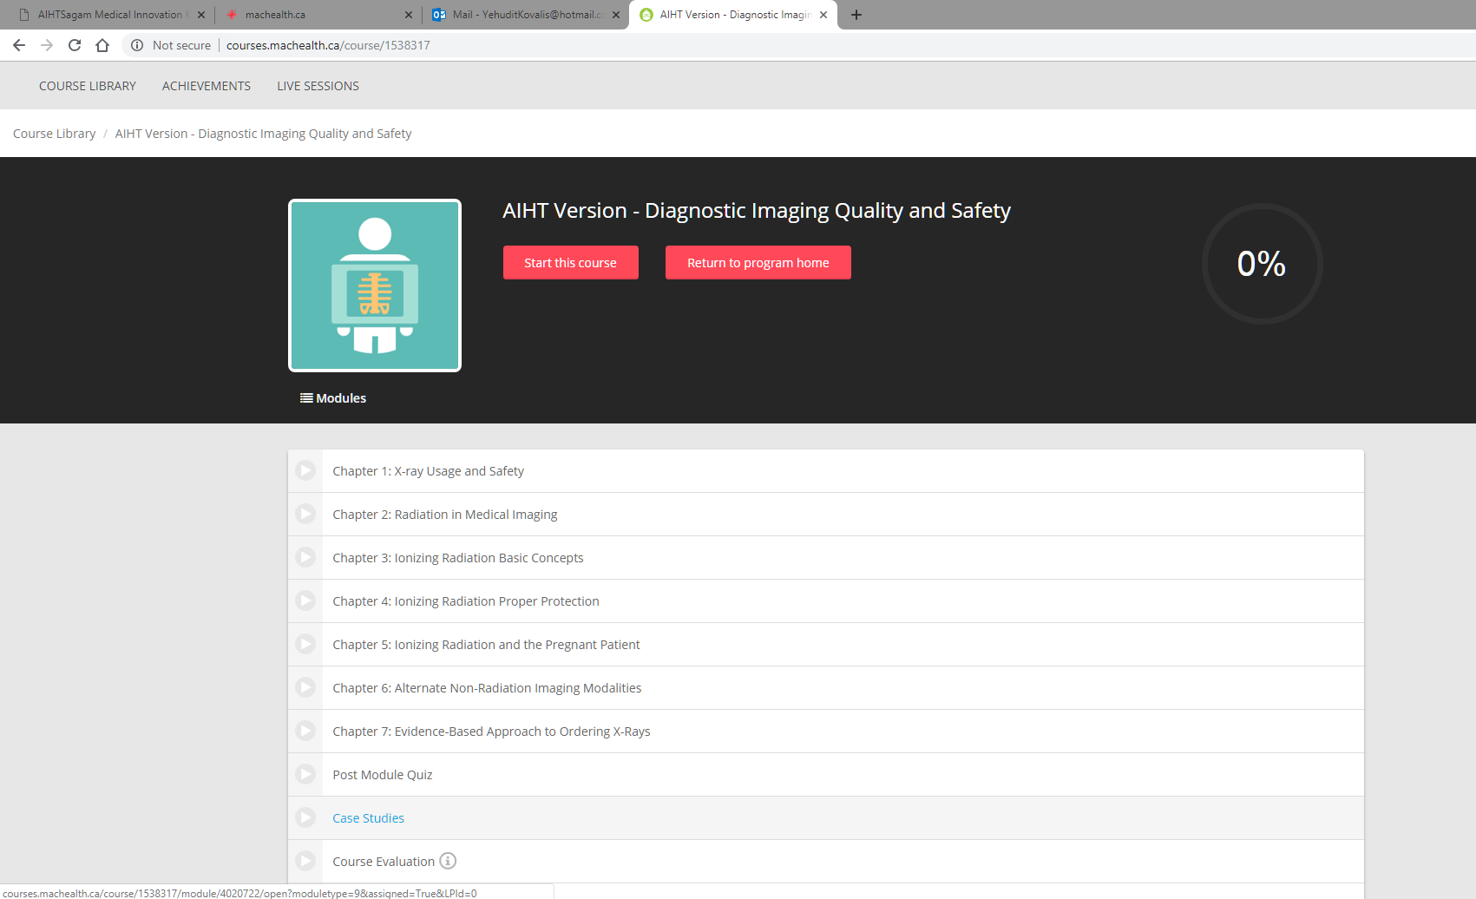
Step 1 – Once you select the course you will be redirected within 5 seconds to the portal to select Start this Course

Slide 26
Step 2 – Once you have completed the modules please complete the Post Module Quiz

Slide 27
Step 3 – Please see the Case Studies available

Slide 28
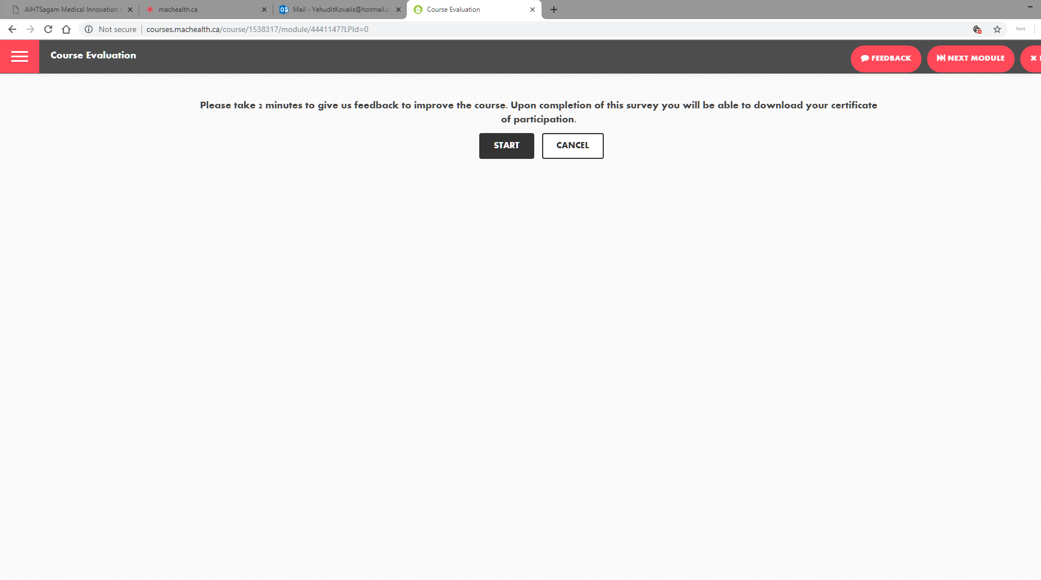
Step 4 – Please complete the course evaluation

Slide 29
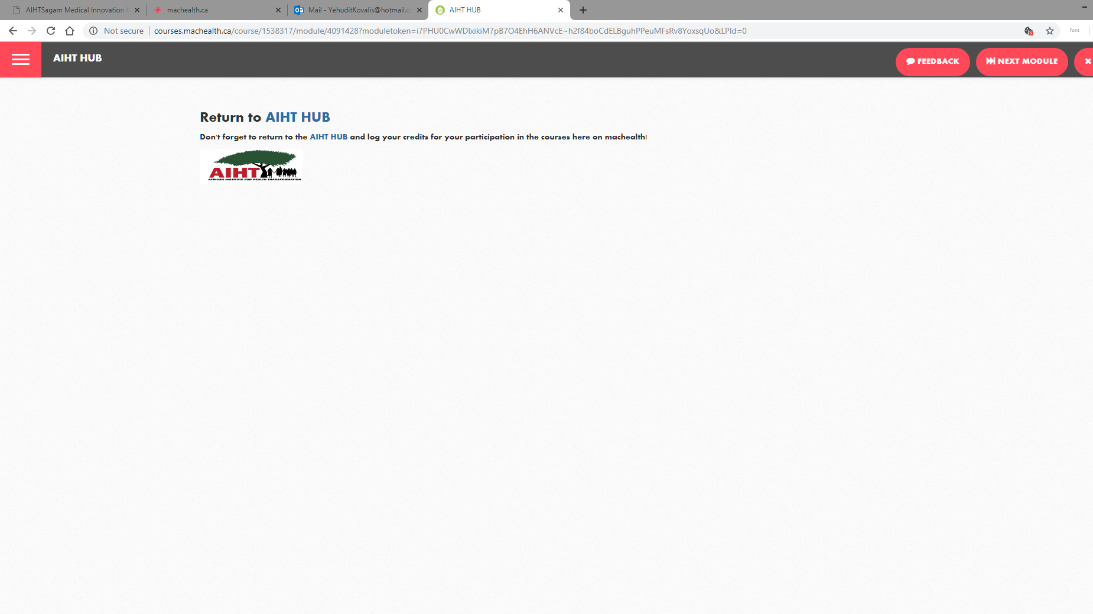
Step 5 – Please return to the AIHT HUB by selecting any of the three buttons and download your certificate of participation and follow the AIHT instructions to log your credits

Slide 30
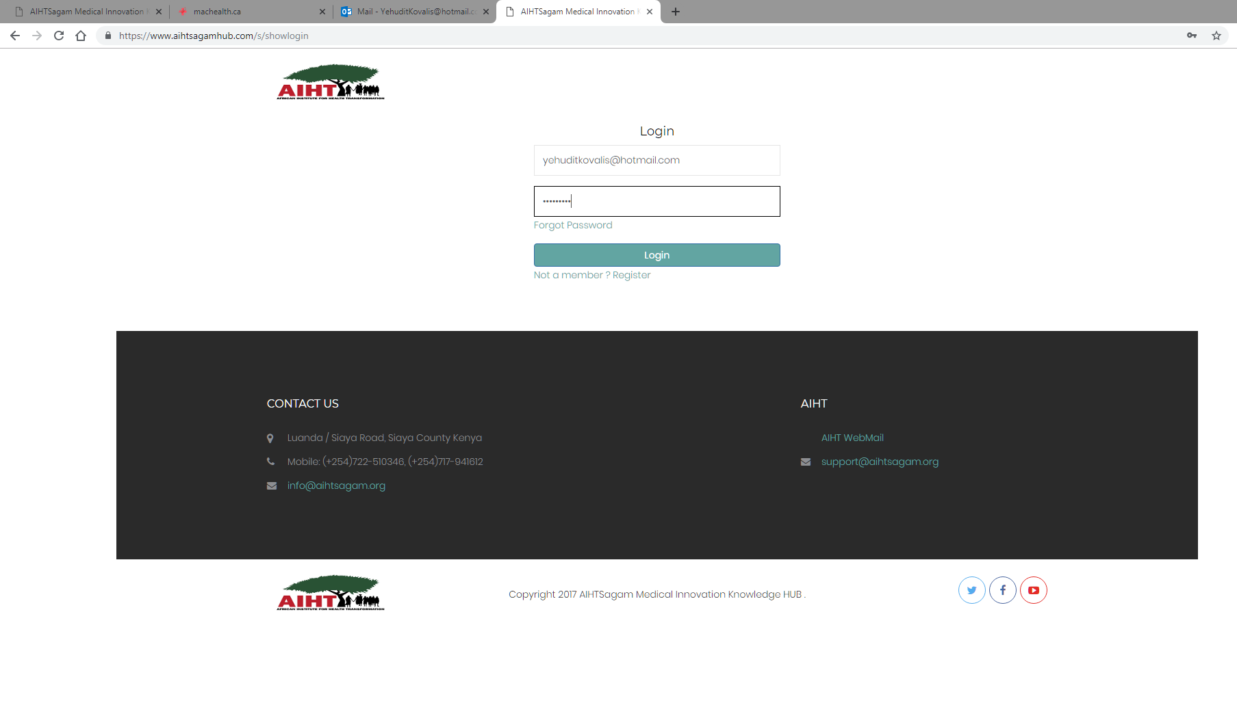
Step 6 – Please enter the AIHT HUB with your HUB User ID and password

Slide 31
Step 7 – Now that you are at the AIHT HUB page, please View Certificates

Slide 32
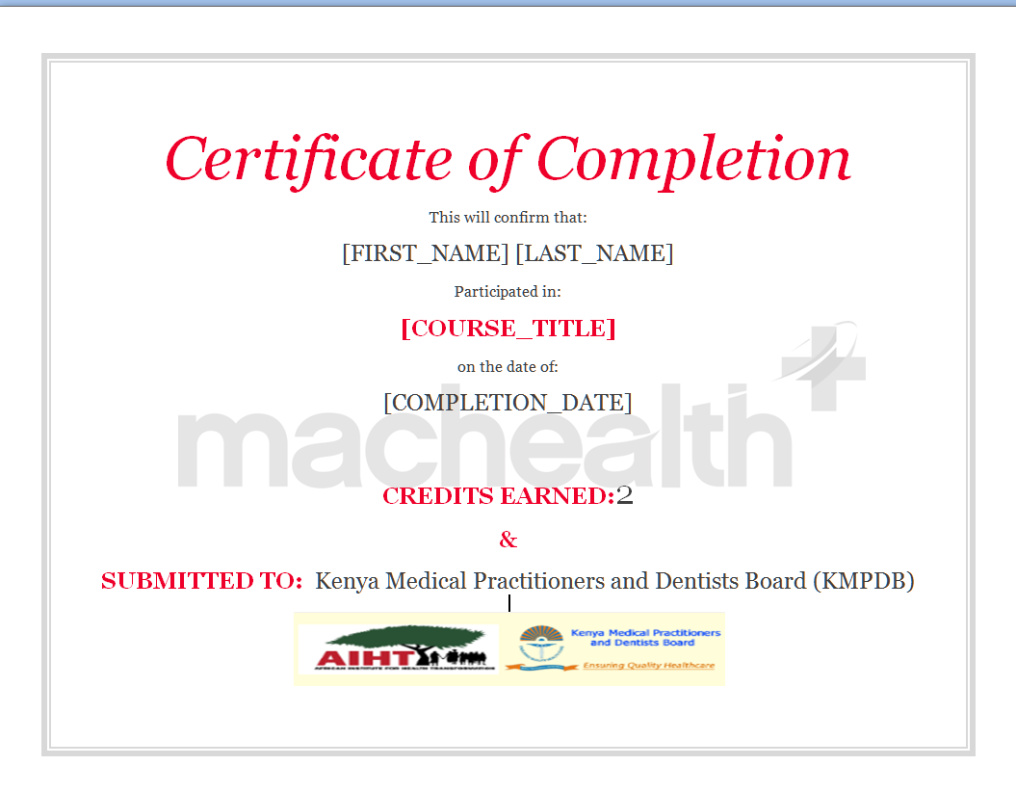
You will receive a Certificate that appears as follows:

Slide 33
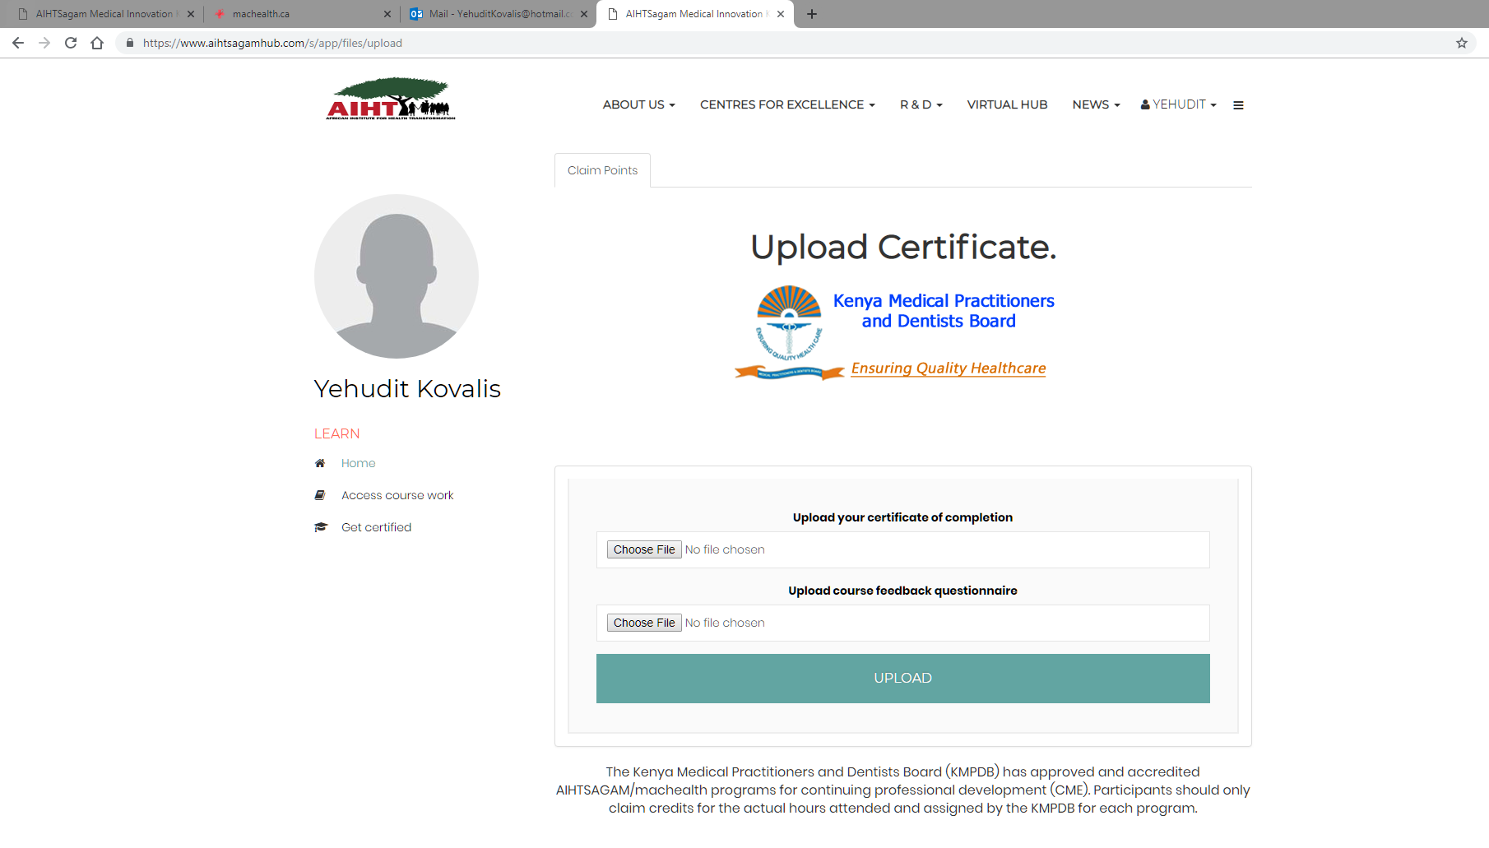
Step 8 – Once you have uploaded your certificate please select the AIHT button to return to claim your points

Slide 34
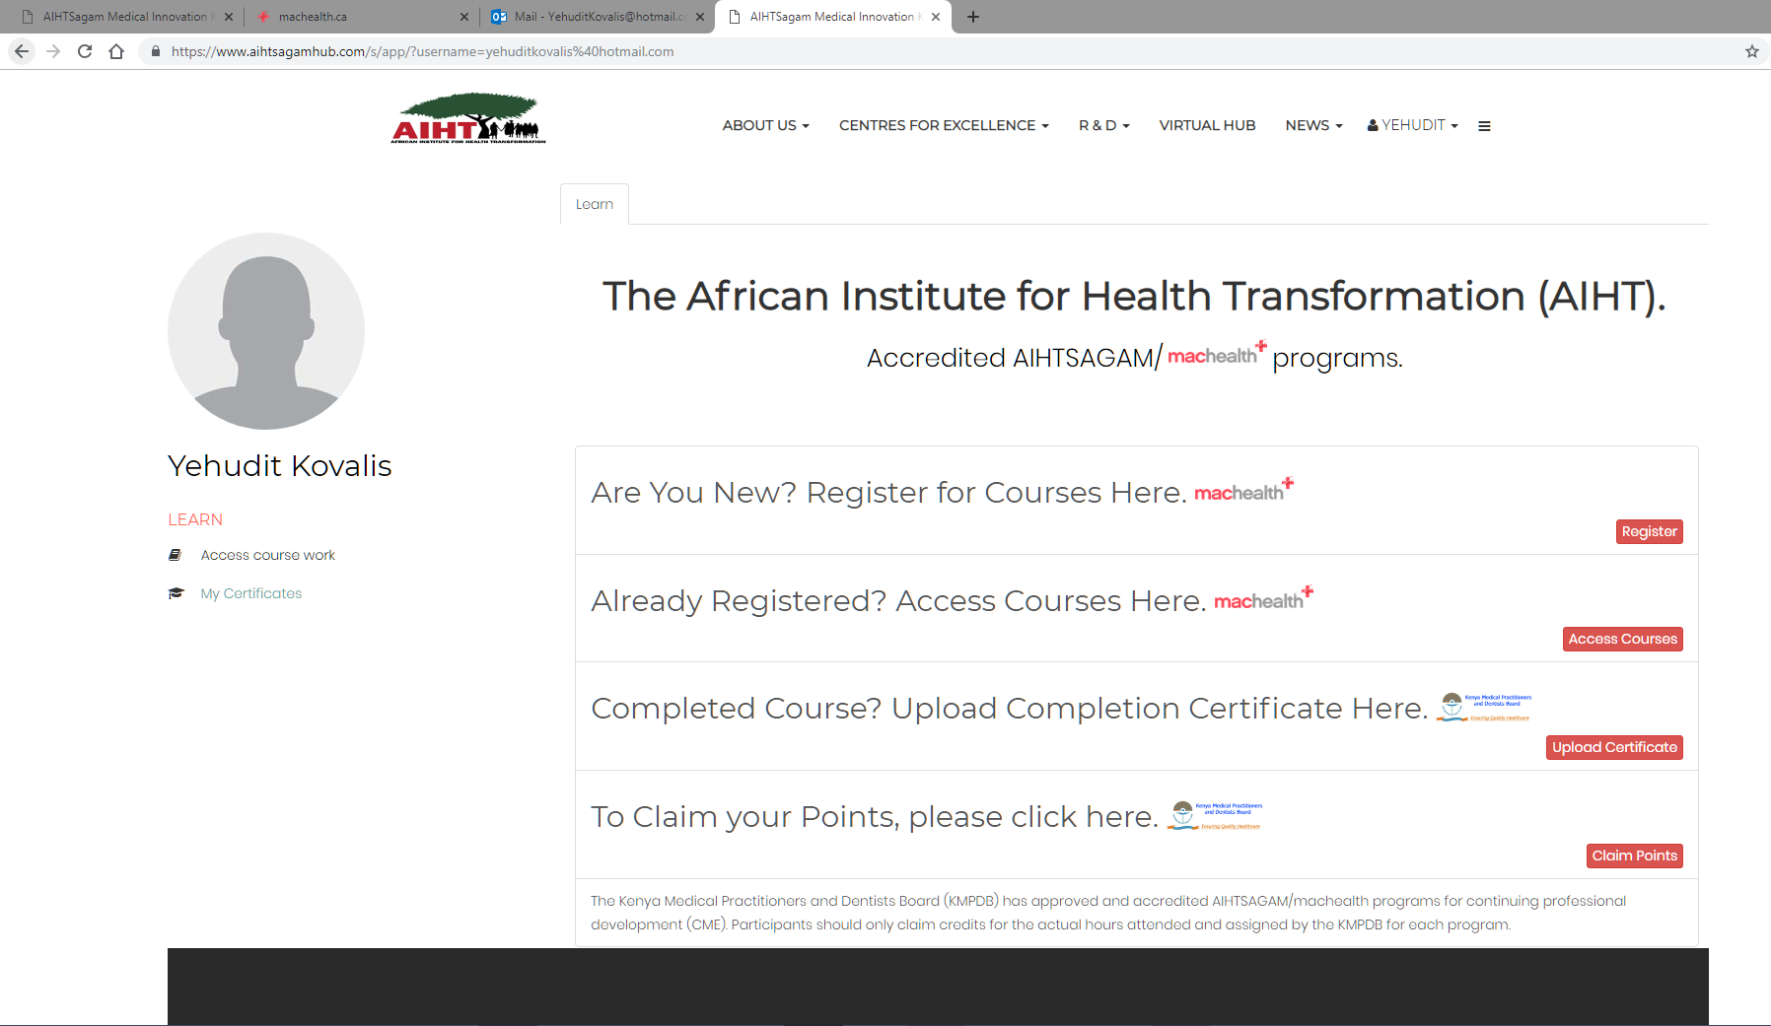
Step 9 –Claim your points

Slide 35
